Slide 1
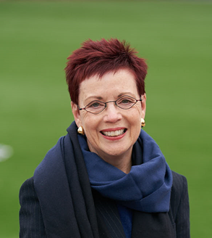
RAISING YOUR CHALLENGING CHILD (Pay What You Can) Parent Group Training
Developed by Dr. Dan Shapiro
This 10-session program is for parents of children (ages preschool through elementary school) with challenging behaviors.
The interactive format is designed to help parents identify the source of their child’s behavior and learn what they can do about it.
At each session, Deborah Marks will provide proactive strategies for raising children with difficult temperaments and developmental differences. Parents will learn to customize their approach to fit their child’s unique profile. Different strokes for different kids!
SESSION TOPICS
Know Your Child
Time–in
Engagement and Understanding
Motivation through Positive Attention
Motivation through Experience
Motivation through Rewards
Problem Solving
Time-out and Ignoring
Pausing for Empathy and Self-Reflection
Accommodations/Interventions
For more information and other course offerings, go to parentchildjourney.com
WITH:
Deborah S. Marks, M.S.W., L.C.S.W.-C
Clinical Social Worker
parentchildjourney.com
LOCATION:
The Beco Building
Host: Fitness for Health
3rd Floor Living Room
5410 Edson Lane
Rockville, MD 20852
Ample parking.
Short walk from
White Flint Metro
WHEN:
Spring 2018
10 Thursday mornings
9:30 – 11:00 AM
March 8 – May 17
(skip March 29)
REGISTER:
CLICK HERE TO REGISTER: Suggested range:
$150-$350
for all ten sessions.
Those who can pay more, thanks very much for supporting those who can’t.

